Slide 1
Flask, Dash or Streamlit,
which framework to use ?

Slide 2
What are my options?
Dash if you already use Python for your analytics and you want to build production-ready data dashboards for a larger company.
Streamlit if you already use Python for your analytics and you want to get a prototype of your dashboard up and running as quickly as possible.
Flask if you want to build your own solution from the ground up.

Slide 3
Flask
Flask acts as a backend framework for the web apps. You are not just restricted to data apps.
Pros:
As it is a framework, a user can build everything up from scratch as per requirements.
Easier to build customizable applications.
More generic web applications can be built using Flask.
As Flask is considered much more stable and mature technology compared to peers.
Active community support
Extensive documentation and related libraries
Multiple learning and practising resources online

Slide 4
Flask
Cons:
Flask does not provide any sort of UI components for machine learning or data science applications.
Intermediate Python knowledge is required, as well knowledge of HTML, CSS, and JavaScript.
Building the solution from scratch can be resource intensive.

Slide 5
Dash
Dash is an open-source Python library used for creating reactive web applications. Dash is a powerful tool for building analytical web applications.
Pros:
Dash can be used with various domains such as data exploration, data analysis, modeling, visualization, instrument control, and reporting.
It is very simple to use. It can be installed directly through pip.
Apart from Python, It can be used with R, Julia, and Jupyter.
Dash applications are reactive.
Dash is more customizable than Streamlit. Also, Dash offers better performance.
Dash has a better, regularly-updated, easy-to-follow documentation.

Slide 6
Dash
Cons:
Dash is more focused on the enterprise market and doesn’t include all of it’s available features in the open source version.
Dash is more verbose than Streamlit; you have to write more code to create simple web applications compared to other frameworks.

Slide 7
Streamlit
Streamlit is another popular tool that is used to create user interfaces. It is an open-source Python library that is used to build powerful, custom web applications for data science and machine learning. Streamlit is compatible with several major libraries and frameworks such as Latex, OpenCV, Vega-Lite, seaborn, PyTorch, NumPy, Altair, and more.

Slide 8
Streamlit
Pros:
Streamlit is accessible for everyone who understands Python. There is no requirement for HTML and CSS.
It has a wide range of UI components. It covers almost every common UI component such as checkbox, slider, a collapsible sidebar, radio buttons, file upload, progress bar, etc. Moreover, these components are very easy to use.
It supports multiple interactive visualization libraries such Latex, OpenCV, Vega-Lite, etc.
Cons:
While not difficult, Streamlit does require some time to learn its own syntax.
Streamlit is not that flexible. It is only based on Python, offers a limited set of widgets, and doesn’t integrate with Python Notebooks.
The data upload limit is only 50Mb.
There is limited support for video/animation.

Slide 9
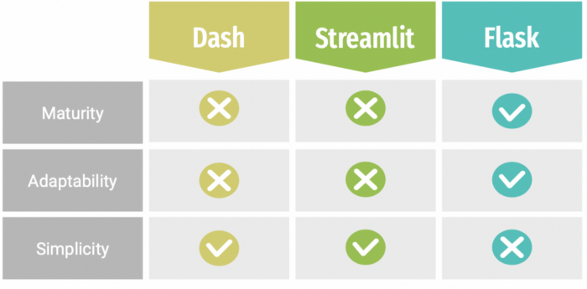
Here’s a table showing the tradeoffs among these three:

